Slide 1
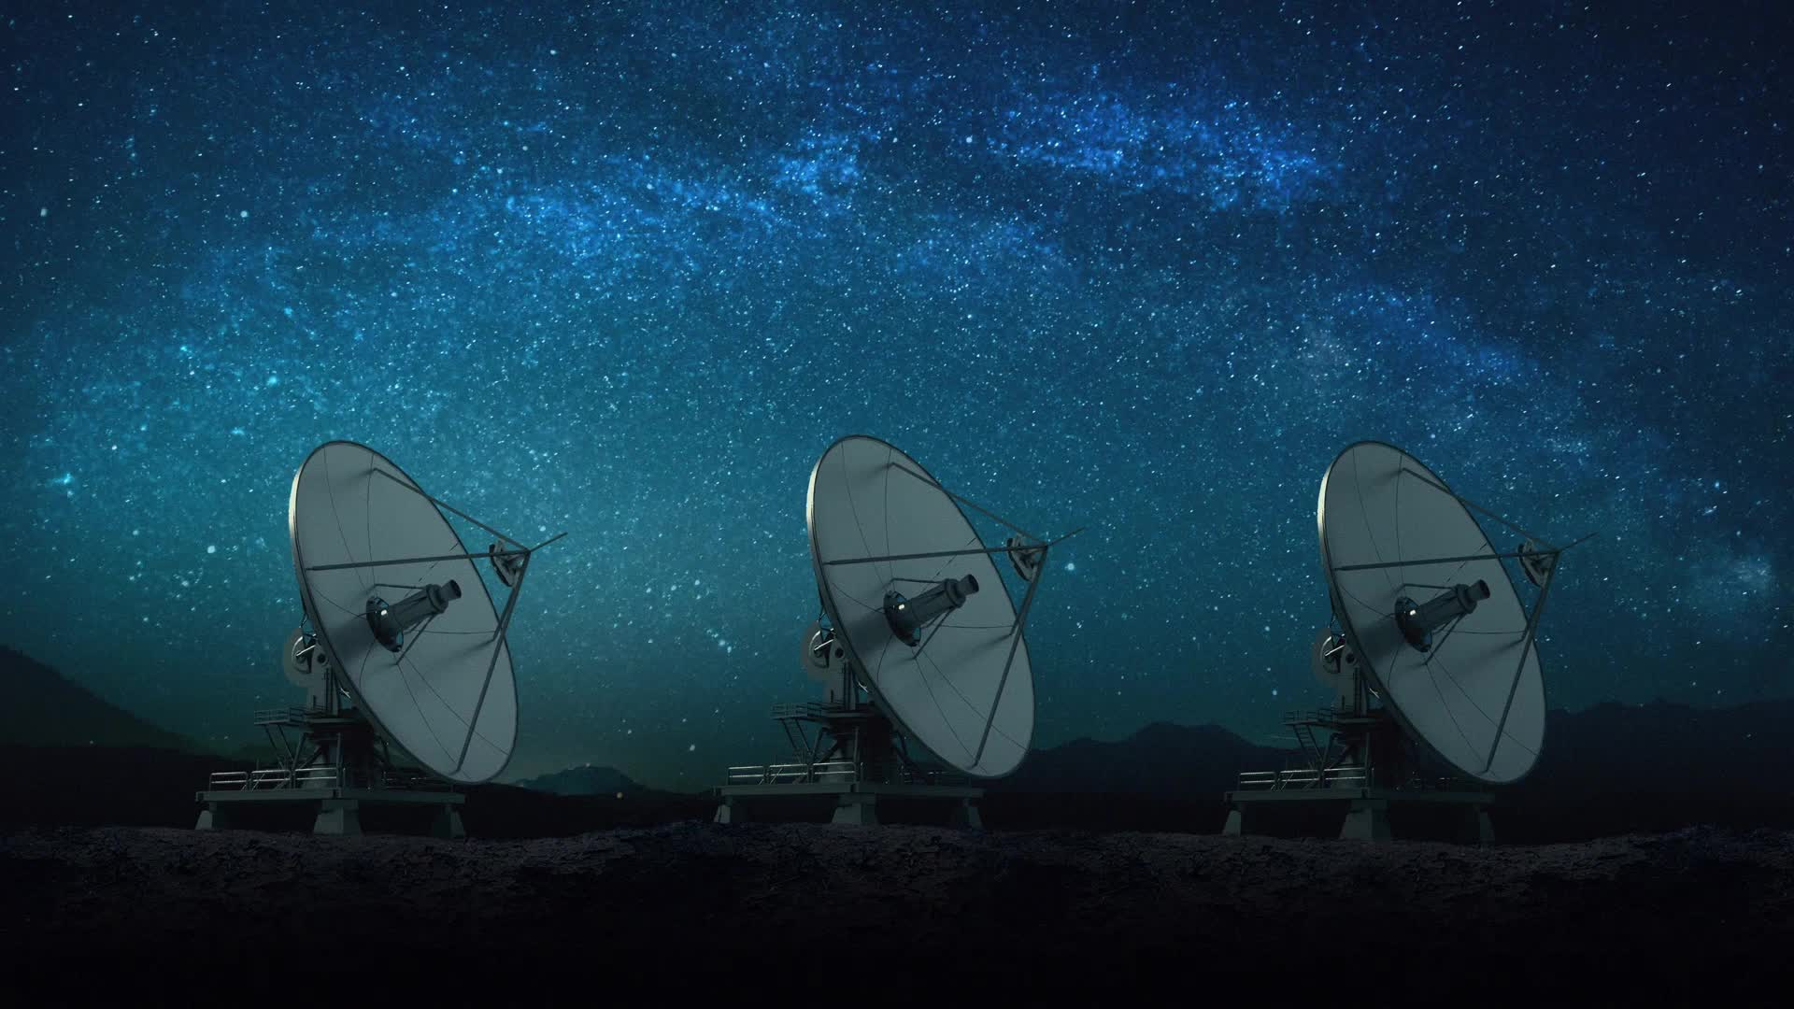
Hunting for Exoplanets with AI
By Robert Shanahan, Adam Downes, Sean Sibindi, Conor Power and Philip Roche

Slide 2
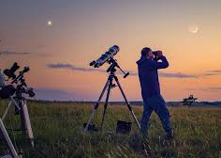
What our work achieves?
Machine learning algorithms could be used to achieve fewer false positives.
It could be faster than traditional methods
We aimed this towards astronomers who are researching exoplanets
Our aim is to build an application that takes CSV datasets of potential exoplanets and uses a pre-trained AI model to classify them, identifying promising candidates for further study.
Nieto, L.A. and Díaz, R.F. (2023) ExoplANNET: A deep learning algorithm to detect and identify planetary signals in radial velocity data, arXiv.org. Available at: https://arxiv.org/abs/2303.09335 (Accessed: 04 October 2025).

Slide 3

Model Training
Cleaned data
Identified X (features) and Y (target labels).
Split into training and testing sets with train_test_split.
Ensured no single feature disproportionately influenced the model.
Combined encoded content into a single column for training.

Slide 4
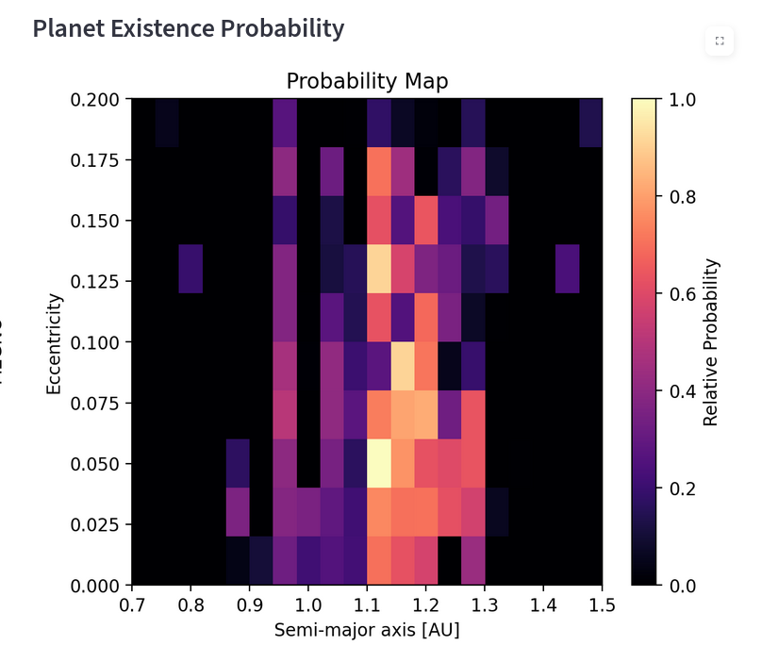
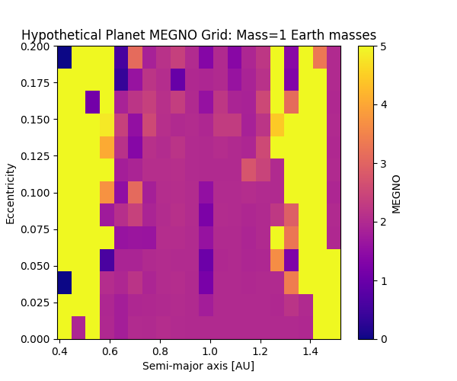
MEGNO - (Mean Exponential Growth factor of Nearby orbits)
MEGNO measures orbital stability. Darker areas = more stable.
Grid-based KDE mapping shows where a planet is most likely to exist.

Slide 5
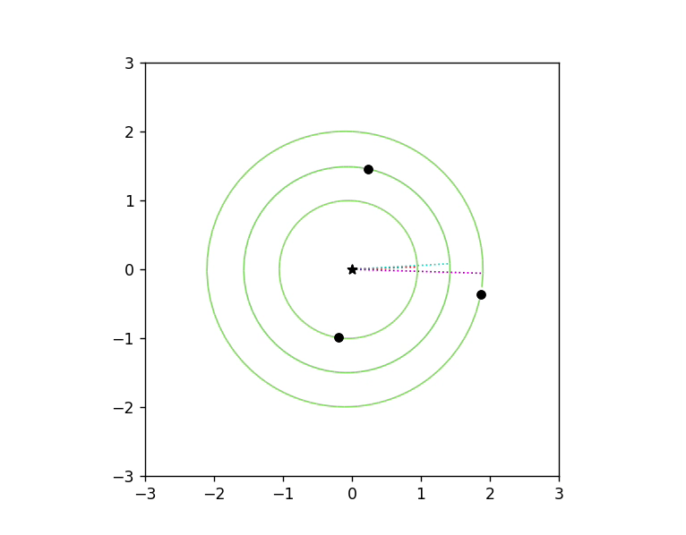
Graphing Orbit
Here we are simulating a star and its orbiting planets.
Simu is to visualize planetary orbits in real-time and color them based on a simple measure of orbital stability.

Slide 6
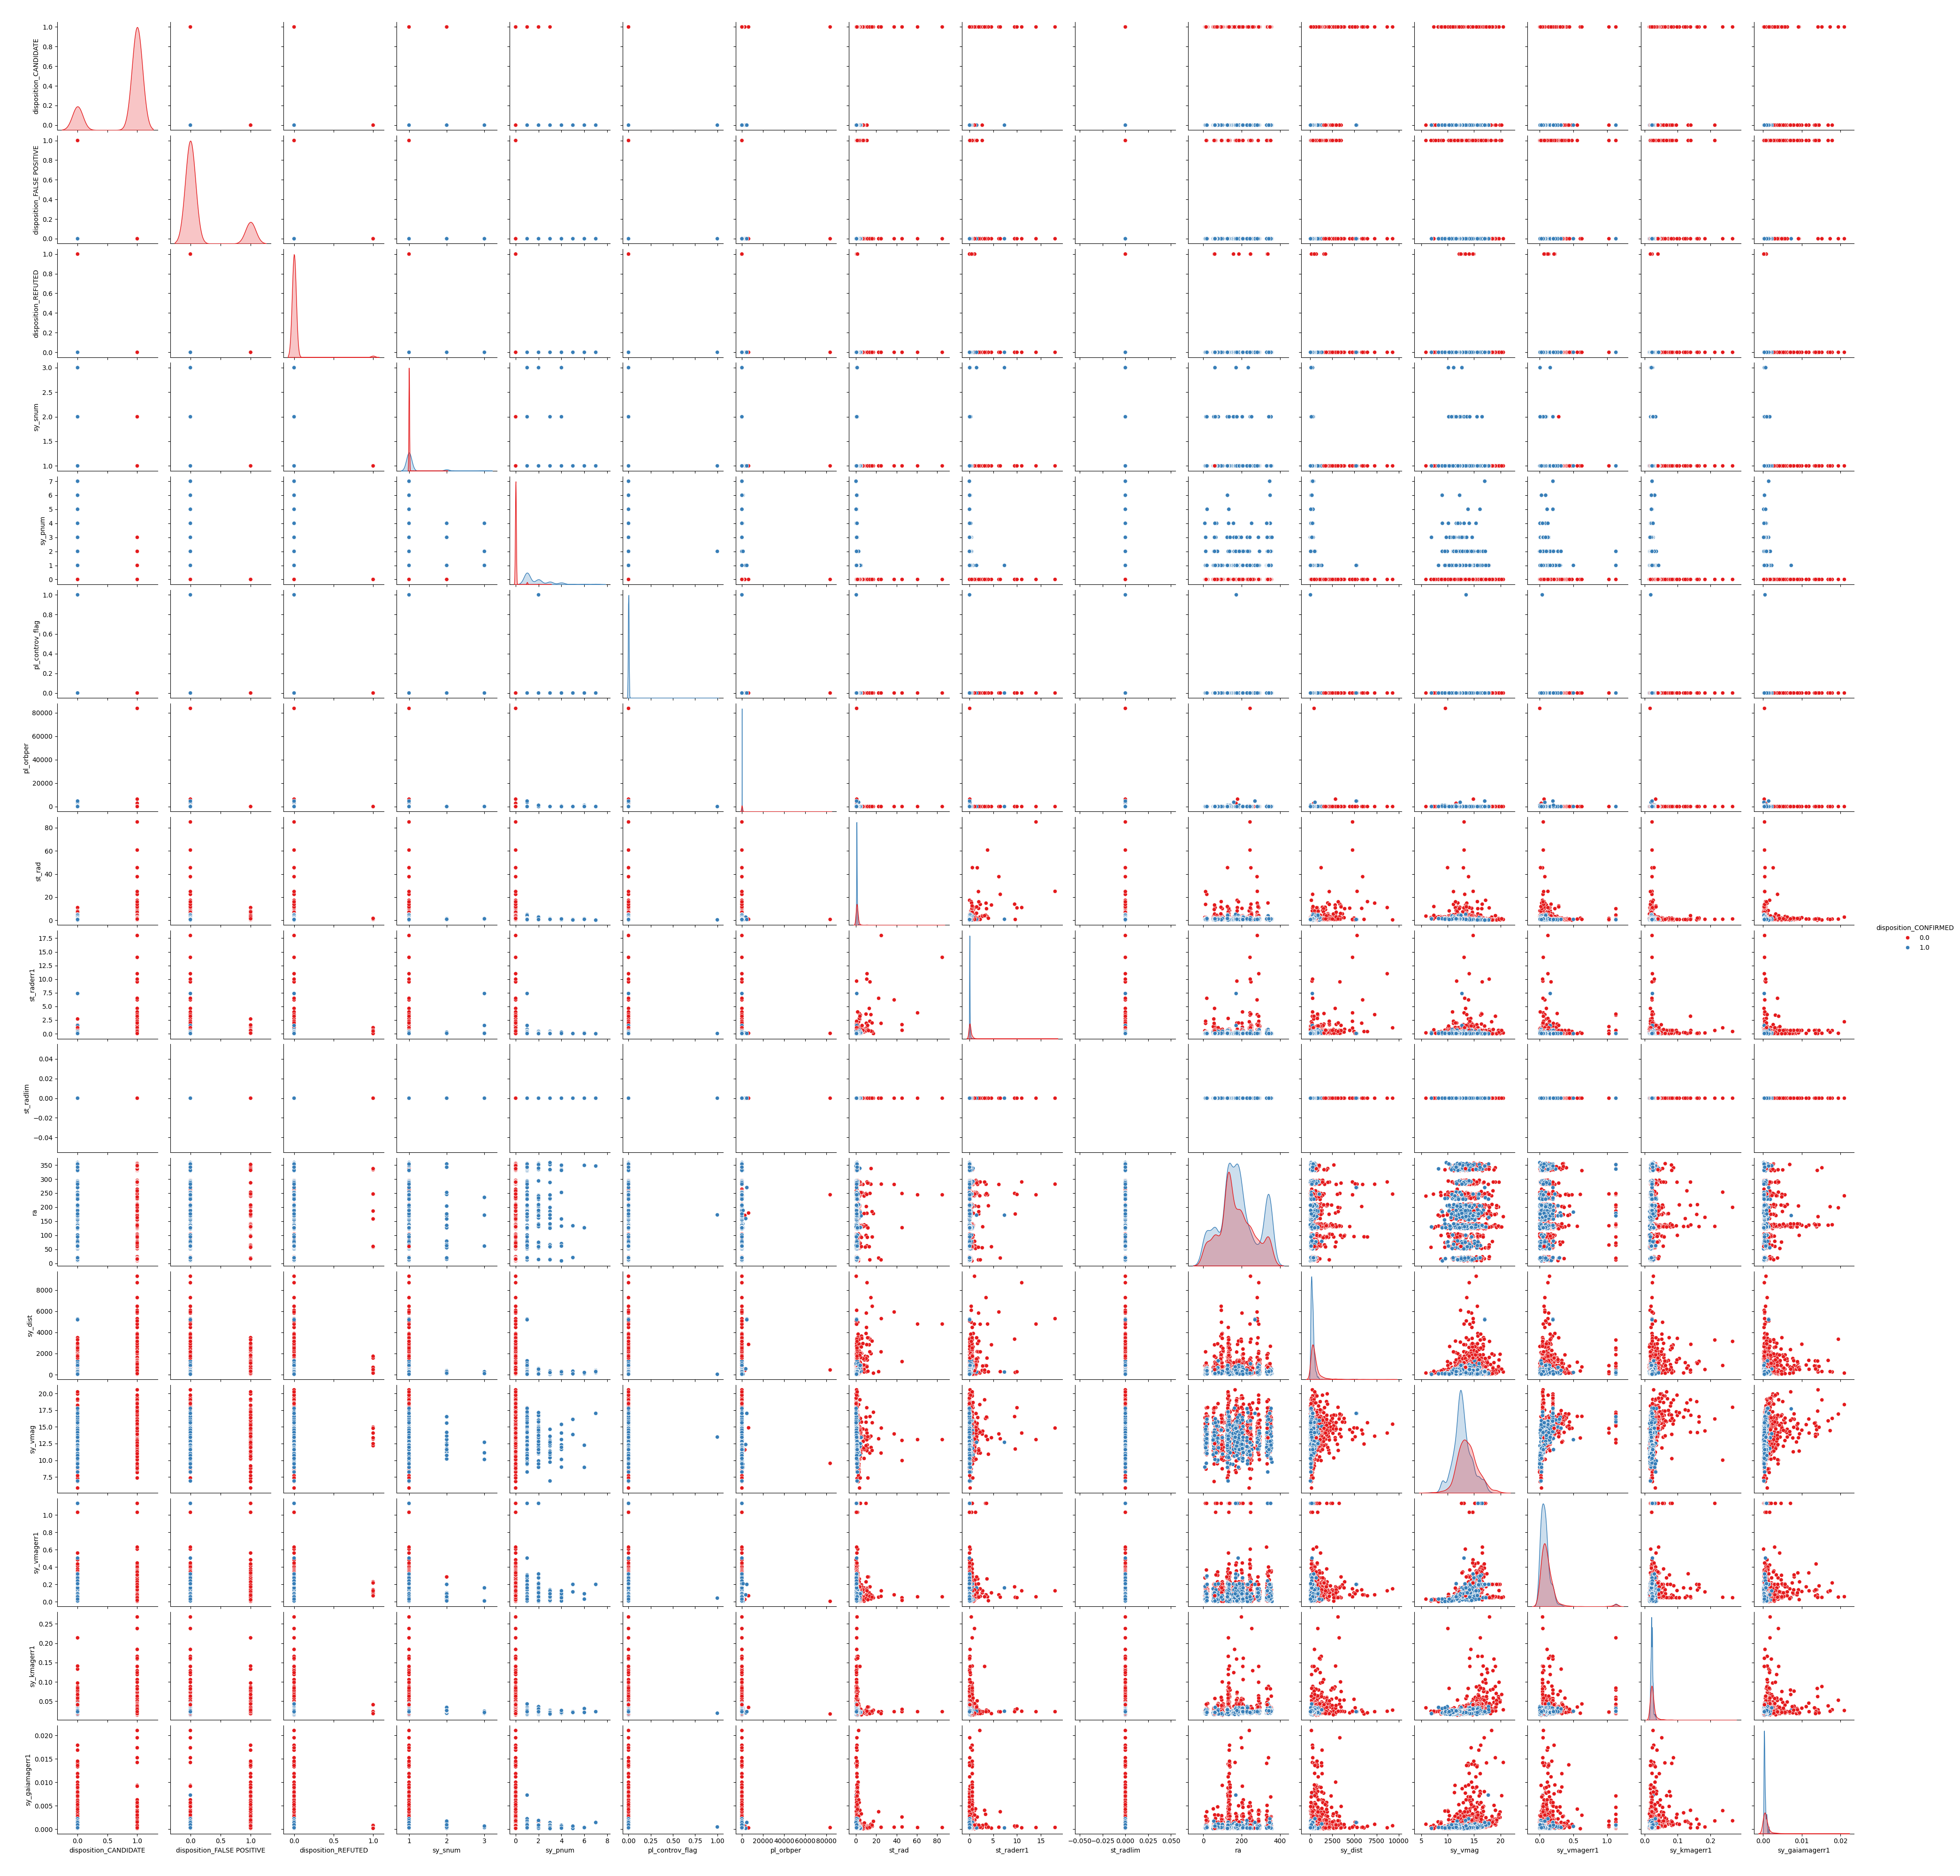
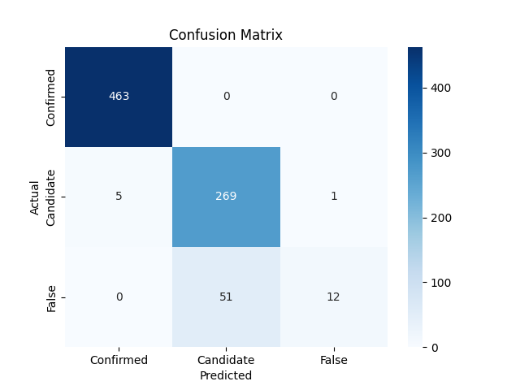
Outputs

Slide 7

Future Works
Add more visualisation
Additional simulation
Scale up the project to detect more celestial bodies
Improve data processing to work with more complex datasets allowing better model accuracy

